Slide 1

DEPARTMENT OF
COMPUTER ENGINEERING
Reverse Image Querying
TE07
Janhavi Anap (03) ©
Prathamesh Hambar (18)
Het Patel (44)
Tejas Sheth (65)
Under the Guidance of
Prof. Rushikesh Nikam

Slide 2
1.Project Conception and Initiation

Slide 3
1.1 Abstract
As days go by, the volume of graphics i.e. visual data keeps increasing exponentially. This presents a more recent and complex set of problems for handling and making use of such vast, disorganized and unregulated data. Multiple organizations have launched many commercial products to tap into this market. There are multiple methods and functions for reverse image querying but most of them are either incomplete or compute-intensive to be a viable option for smaller use cases. In this study, we have implemented and improvised a rudimentary yet efficient solution by using the cosine similarity model to extract similar images for the given input image from the user. The model used is explained comprehensively together with visual representations. We have also explored multiple use cases that can be used as commercial products. The resulting web application can be utilized to act as a reverse image search engine as a standalone application or can be embedded as a sub-module in a larger application.
Reverse Image Search Engine

Slide 4
1.2 Objectives
Colour Based Reverse Image Search
To retrieve images with similar color.
To build an interface that enables similar content-based image search.
To overcome the limitations of text based search.
Reverse Image Search Engine

Slide 5
1.3 References & their Key Takeaways
(PDF) Search by Image: A Novel Approach to Content Based Image Retrieval System - Content-based image retrieval (CBIR) uses the visual options of a picture such as color
(PDF) Clustering visually similar images to improve image search engines - Similar images can be clustered using the k-means algorithm.
Exploring_the_Impact_of_Similarity_Model_to_Identify_the_Most_Similar_Image_from_a_Large_Image_Database - Comparing similarity accuracies of various models like cosine similarity, euclidean distance, manhattan distance, etc.
(PDF) Content-Based Image Retrieval Systems: A Survey - Comparative study of commercially available CBIR systems today.
Reverse Image Search Engine

Slide 6
1.4 Problem Definition
To build a web application that retrieves similar images when given an input image based on their colour using image feature extraction.
Reverse Image Search Engine

Slide 7
1.5 Scope
Protect Copyrights
Find Object Details
Authenticity
Reverse Image Search Engine

Slide 8
1.6 Technology stack
Python: General Programming Language used to code the model, includes several libraries.
Python libraries: Numpy, Matplotlib, PIL (Python Imaging Library), pandas, streamlit, os.
VS Code: IDE to run, train and test the ML model. Plenty of extensions, open-source, cross-platform support,
Git & GitHub: Version Control System used for collaboration.
Streamlit: Streamlit is a free and open-source framework to rapidly build and share beautiful machine learning and data science web apps.
Google Workspace: Project Management Tool to improve team coordination and file sharing.
Teamgantt: Project Management Tool to improve team coordination and file sharing using Gantt chart.
Reverse Image Search Engine

Slide 9
2. Project Design

Slide 10
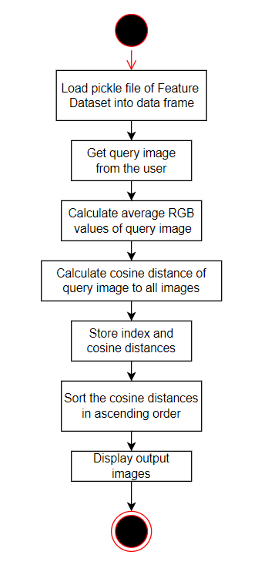
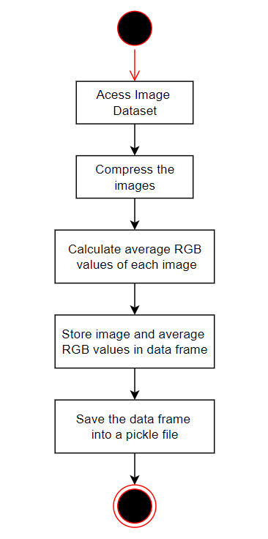
2.1 Proposed System

Slide 11
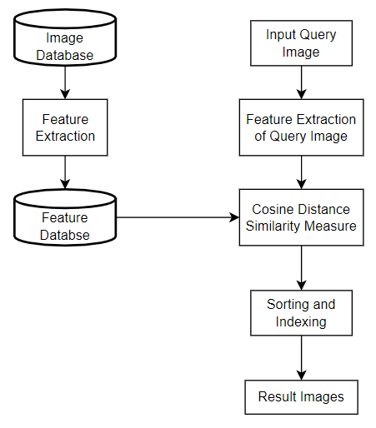
2.2 Design (Flow of Modules)

Slide 12
2.3 Description Of Modules / Use Case
Compress (by resize) the dataset images,
Extract features from the images,
Store the extracted data in a pickle file,
Give a input query image,
Calculate the cosine distance from query image,
Retrieve the results.

Slide 13
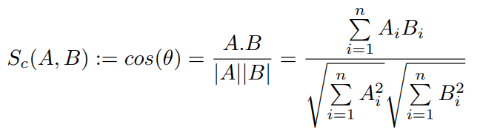
3.Implementation

Slide 14
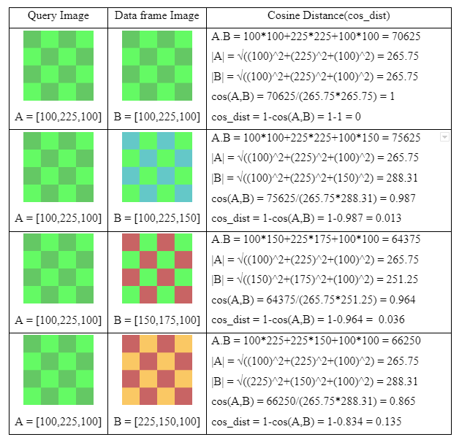

Slide 15
3.2 Execution

Slide 16
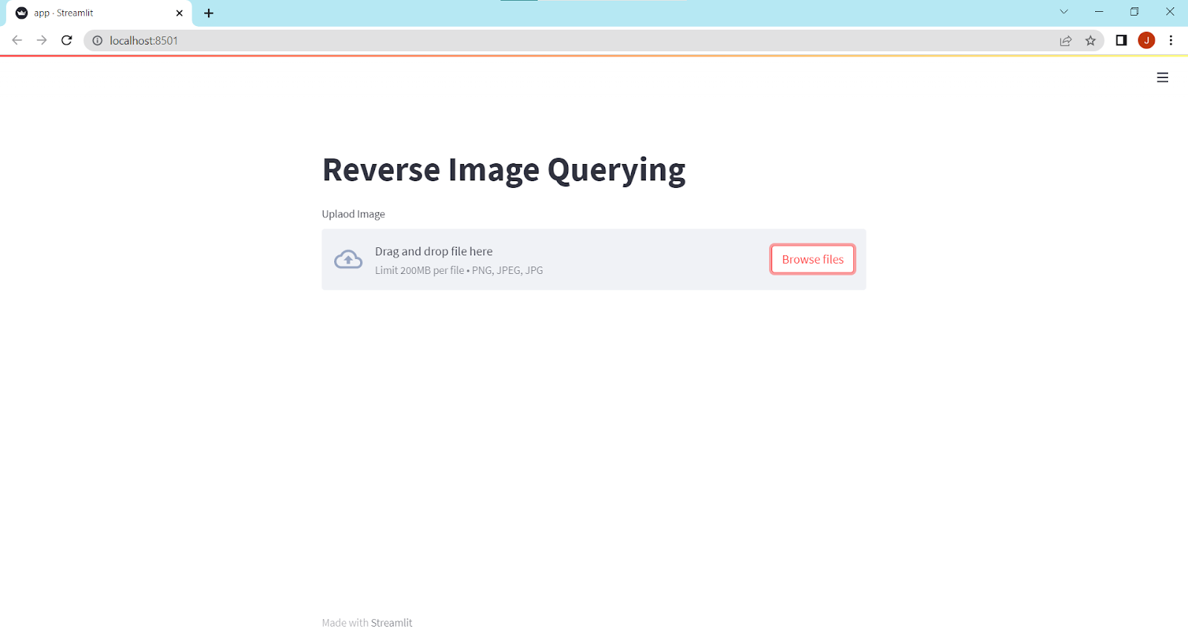
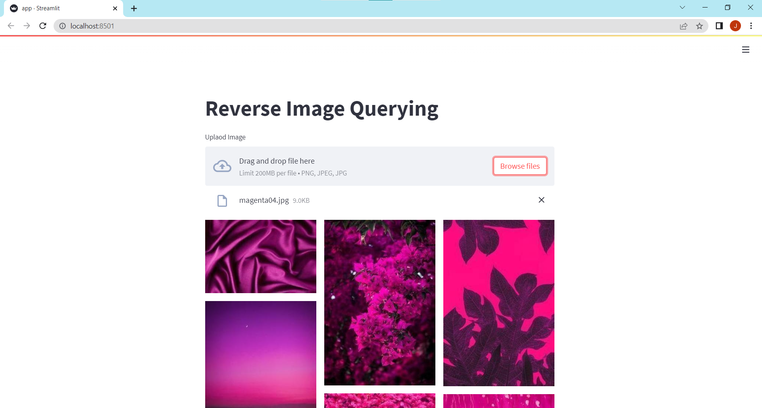
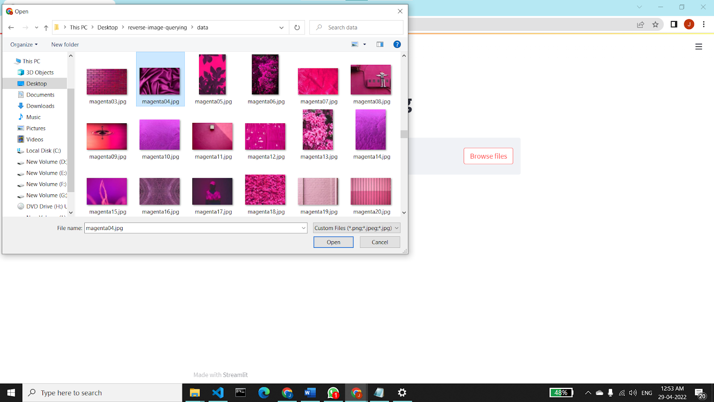
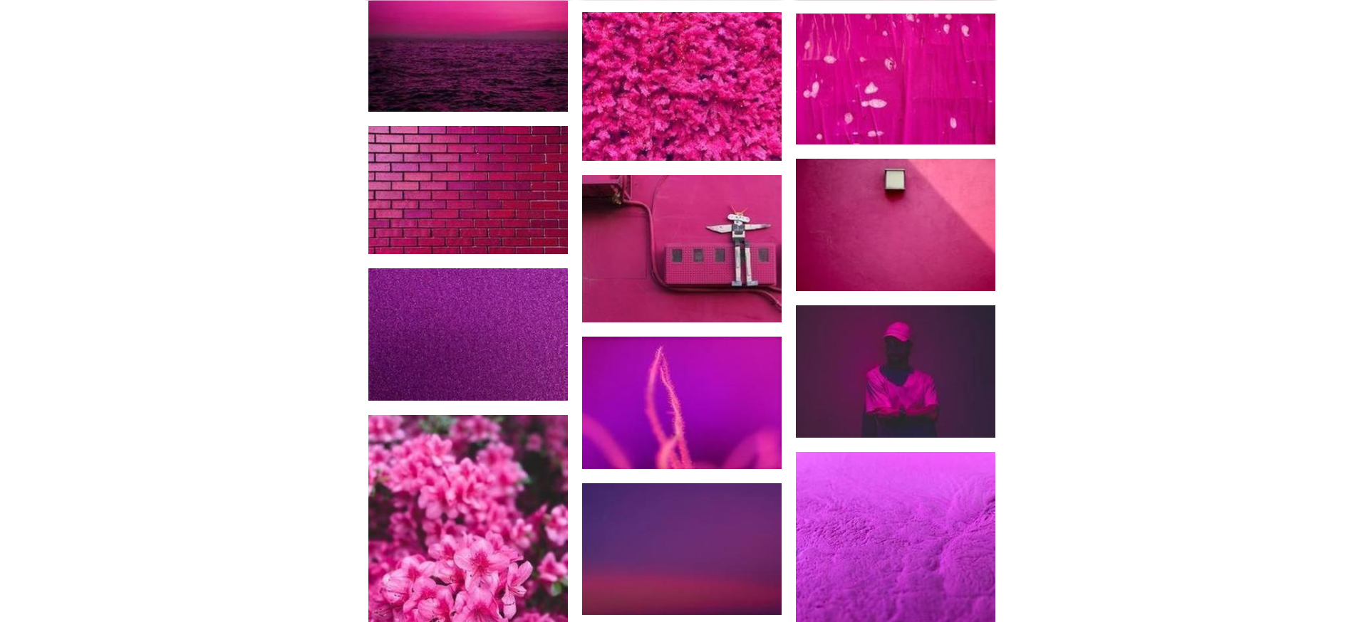
4. Results

Slide 17
5. Conclusion
According to our results, using the best similarity model we choose, there has been a significant increase in the accuracy, based on the colour attributes. We managed to achieve great results using simple yet highly effective algorithms.

Slide 18
6. References
Chen, Ye. (2020). Exploring the Impact of Similarity Model to Identify the Most Similar Image from a Large Image Database. Journal of Physics: Conference Series. 1693. 012139. 10.1088/1742-6596/1693/1/012139.
Adrakatti, Arun and Wodeyar, R. and K.R, Mulla. (2016). Search by Image: A Novel Approach to Content Based Image Retrieval System. International Journal of Library Science. 14. 41-47.
Deselaers, Thomas and Keysers, Daniel and Ney, Hermann. (2003). Clustering visually similar images to improve image search engines.
Kekre, Hemant and Mishra, Dhirendra and Narula, Ms and Shah, Vidhi. (2011). COLOUR FEATURE EXTRACTION FOR CBIR. International Journal of Engineering Science and Technology.
Veltkamp, Remco and Tanase, Mirela. (2000). Content-Based Image Retrieval Systems: A Survey. Technical report, Utrecht University.
Luo, Bo and Wang, Xiaogang and Tang, Xiaoou. (2003). World Wide Web Based Image Search Engine Using Text and Image Content Features. Proc SPIE. 10.1117/12.476329.
Brin, S., and Page, L. (1998). The anatomy of a large-scale hypertextual web search engine. Computer Networks and ISDN Systems, 30(1-7), 107–117.

Slide 19
Thank You

Slide 20
Questions?

